Slide 1


Number Systems
Module 1- Data Representation
Edited 4 Nov 2003 brl
1.1

Slide 2
Coding
ALL data stored and processed by digital computers is in binary code. 1s & 0s
The 1s & 0s are represented by voltages in the computer
eg +5 volts = binary 1 and 0 volts = binary 0
Many different binary coding systems exist in order to cope with different number and data types
Examples are:
  unsigned integers 5, 77, 92
  signed integers -34, -123
  reals 3.338, -1234.6543
  characters a,b,c,
  strings Once upon a time there was only machine code
1.3

Slide 3
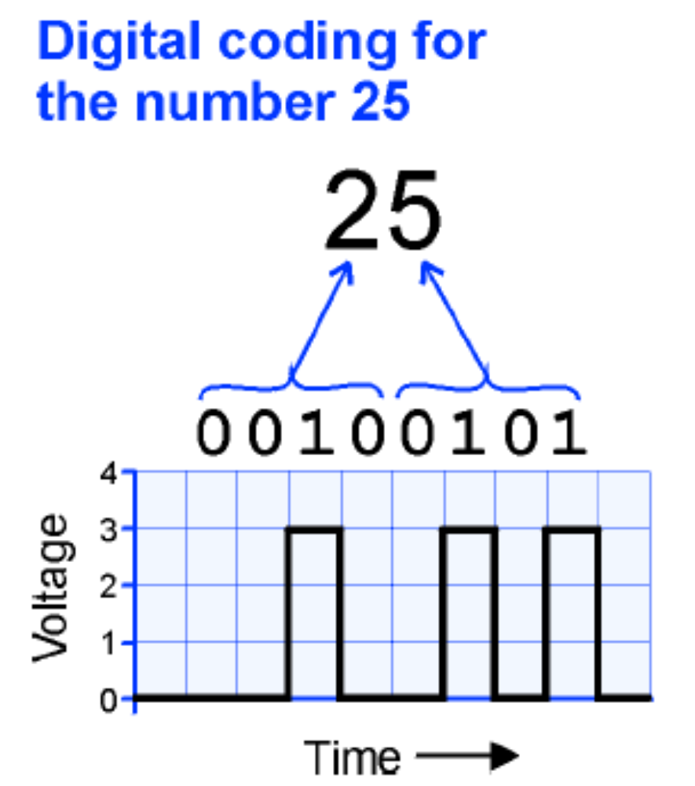
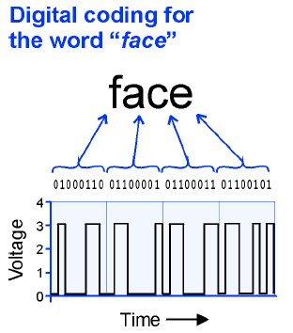

Slide 4
Objectives
After studying this module, students should be able to:
Understand and use various number systems
Convert numbers between different number systems
Perform arithmetic on data in various number systems
Understand and use data encoding systems
1.2

Slide 5
Binary numbers
00000001 = 1
00000010 = 2
00000011 = 3
00000100 = 4
00000101 = 5
00000110 = 6
00000111 = 7
00001000 = 8
00001001 = 9
00001010 = 10
Binary numbers are widely used in applications that deal with a choice of one or two conditions, example, on-off or high-low.
Binary numbers use only two digits 0 and 1 for different place counts
The train of pulses is a digital signal containing information about the sequence of HIGH and LOW levels.
The binary numbers are usually written in groups of four or eight. Each 0 of 1 is called a bit. A group of four bits is a nibble. Eight bits make a byte.

Slide 6

Counting with binary numbers
Decimal system
Binary system

Slide 7
Number Systems
We use number systems based on positional number systems where the position of a digit within the number determines the digits value
For the decimal number system the positional values are: 10⁴ 10³ 10² 10¹ 10⁰
Example
23₁₀ = 2 x 10¹ + 3 x 10⁰
= 2 x 10 + 3 x 1 = 20 + 3 = 23
1.4
Notes:
There is more text on this slide but I don’t know how to do it.

Slide 8
However, with the binary system the weights increase from right to left in powers of two for each bit, as shown in the figure below:
Binary weight
Weight value
2⁷ 2⁶ 2⁵ 2⁴ 2³ 2² 2¹ 2⁰
128 64 32 16 8 4 2 1
H G F E D C B A
Binary point
The right-most bit is the least significant bit, (LSB) and the left-most bit is the most significant bit (MSB). Only eight places are illustrated, but more places can be used for bigger numbers

Slide 9
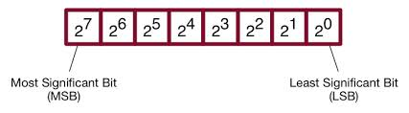

Slide 10
Example
Example: convert the binary number (1101)₂ to decimal form.
Solution:
Binary weight: 2³ 2² 2¹ 2⁰
Weight value: 8 4 2 1
Binary Number: 1 1 0 1
= 1 x 8 + 1 x 4 + 0 +1 x 1 = (13)₁₀
Highest decimal number = 2^{n} -1

Slide 11
Representation of fractional numbers
Fractional numbers can also be represented in binary form by placing bits to the right of the decimal point. The weights of the digit in a binary number are:
2^{n-1} ……2³ 2² 2¹ 2⁰ . 2⁻¹, 2⁻²,…..2^{-n}
Binary point

Slide 12
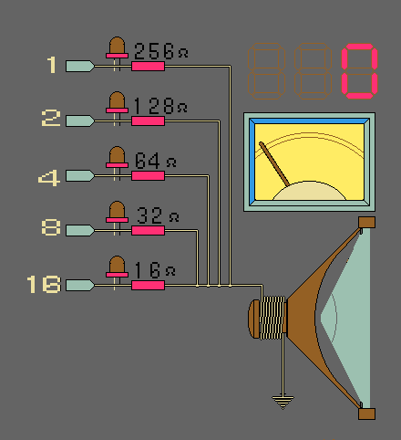
Binary-decimal-real values

Slide 13
Decimal–to-Binary Conversion
Repeated Division-by-2 Method
Repeated Multiplication-by-2 method
  Converting decimal fractions to binary

Slide 14
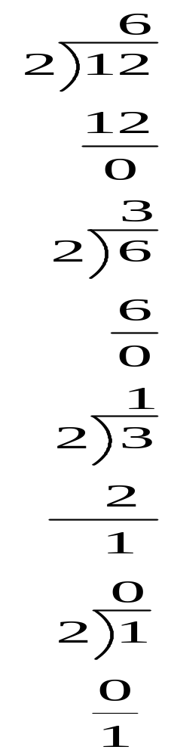
Remainder
?? EXAMPLE:
Convert the decimal number 12 to binary
Step 1
0
LSB
Step 2
0
We divide each quotient by 2 until there is a 0 quotient
Step 3
1
Indication to stop
Step 4
1
MSB
1100

Slide 15
Converting decimal fractions to binary
Carry Fractional part
Step 1 0.3125 x 2 = 0.625 Carry
0 MSB
Step 2 0.625 x 2 = 1.25
1
Step 3 0.25 x 2 = 0.50
0
Step 4 0.50 x 2 = 1.00
1 LSB
0.0101

Slide 16
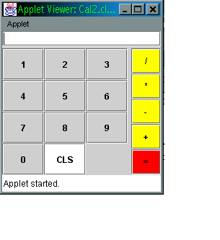
Electronic translators
Keyboard input
Processing unit
Encoder
Output
Decoder
Decimal
Binary
decimal
9
1001
9
The diagram above illustrates a typical system that may be used to translate from decimal s to binary and back to decimals.

Slide 17
Binary Arithmetic
Binary arithmetic is fundamental to all digital computers and many other types of digital systems. To understand digital systems, one must know the basics of binary
  Addition
  Subtraction
  Multiplication
  division

Slide 18
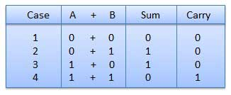
Binary addition
There are four basic rules for adding binary digits

Slide 19
Example
Add 1001 and 0110.
(1001)₂ (9)₁₀
+(0110)₂ +(6)₁₀
(1111)₂ (15)₁₀

Slide 20
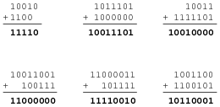

Slide 21
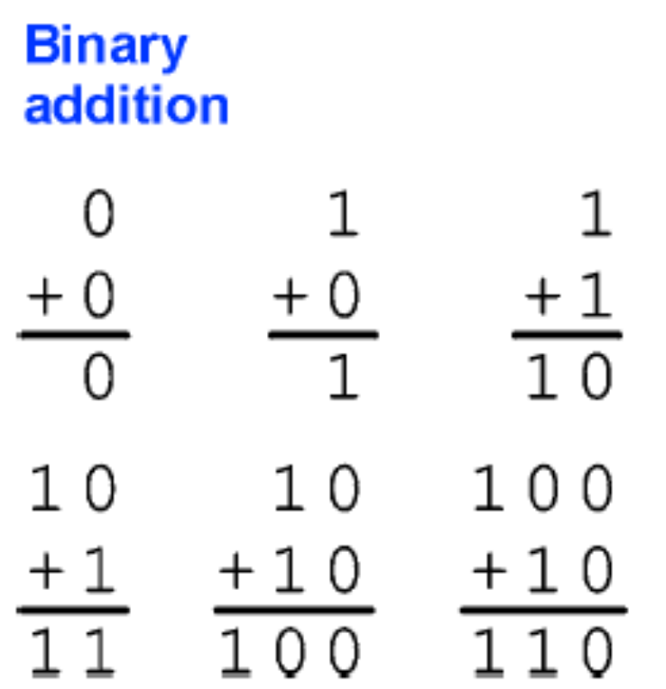
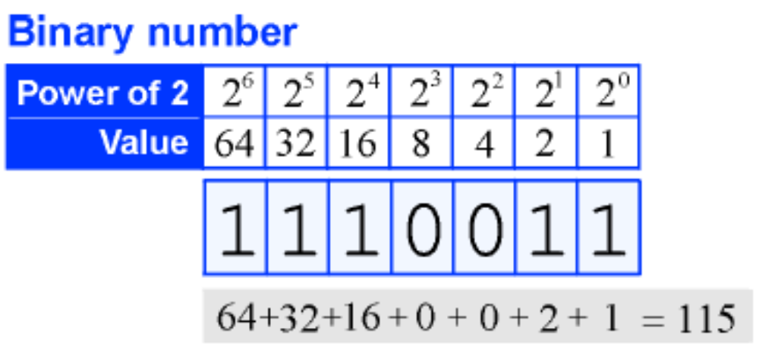
Example2

Slide 22
Subtraction
There are four basic rules for subtracting binary digits:
0 – 0 = 0
1 – 1 = 0
1 – 0 = 1
10 – 1 = 1 (0 – 1 with a borrow of 1)

Slide 23
Example
101
011
010

Slide 24
Subtraction by adding the complement
Obtaining the 1’s Complement of a binary number
The 1’s complement of a binary number is found by simply changing 1s to 0s and all 0s to 1s.
Binary Number 1’s Complement
10101 01010
10111 01000
111100 000011
11011011 00100100

Slide 25

Example
Subtract 0011 from 1001 (i.e subtract 3 from 9)
1001 (original minuend)
+1100 (complement)
0101
1 (carry around)
0110 (answer)

Slide 26
Example
Subtract 1001 from 0011 (i.e subtract 9 from 3)
0011 (original minuend)
+0110 (complement)
1001 (sum)
- 0110 (answer)

Slide 27
Rules for 1’s complement subtraction
Convert the subtrahend to its complement by changing 0 to 1 and 1 to 0 for all digits
Add the complement to the minuend, which is the number from which the subtrahend is to be subtracted.
If there is a carry- out of 1 from the most significant place at the left, move this carry around to the least significant place at the right and add the 1 in this column.

Slide 28
Rules for 1’s complement subtraction cntd.
If there is no carry-out for this last column, the answer for the subtraction is negative, meaning that the subtrahend is larger than the minuend. In this case, take the complement of all the digits in the sum and give this answer a negative sign.

Slide 29

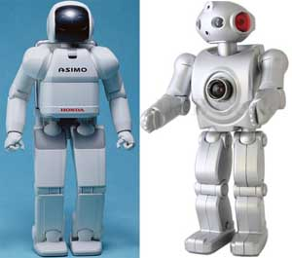

Slide 30
Subtraction by adding the complement
Obtaining the 2’s Complement of a binary number
The 2’s complement of a binary number is found by adding 1 to the 1’s complement of a number
Binary Number
2’s complement
110
001 1’s complement
+1 Adding 1
010 2’s complement

Slide 31

2’s Complement subtraction
For subtracting a smaller number from a larger one, the 2’s complement method is applied as follows;
  Determine the 2’s complement of the smaller number
  Add the 2’s complement to the larger number.
  Discard the final carry (there is always a carry in this case)

Slide 32
Example, subtract 1011 from 1100, using the 2’s method
1100
+0101 2’s complement of 1011
1 0001 discard carry
0001 final answer

Slide 33
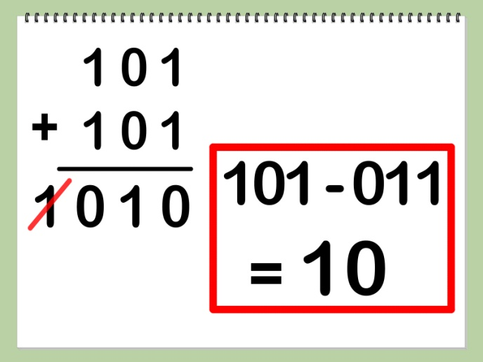

Slide 34
2’s Complement subtraction
For subtracting a larger number from a smaller one
  Determine the 2’s complement of the larger number
  Add the 2’s complement to the smaller number
  There is no carry from the left-most column, the result is in 2’s complement form and is negative.
  To get the final answer, take the 2’s complement of the result, and change the sign

Slide 35
Example, subtract 11100 from 10011, using the 2’s method
10011
+00100 2’s complement of 11100
10111 no carry; 2’s complement of answer
-01001 final answer

Slide 36
Binary representation of signed numbers
The capability of handling both positive and negative numbers is a requirement of any digital system that does arithmetic operation.
A signed number consists of sign and magnitude information.
The sign indicates whether a number is positive or negative and the magnitude is the value of the number.

Slide 37
The sign is represented by including an additional bit along with the magnitude bits. Conventionally a 0 represents a positive sign and a 1 represents a negative sign. For example, in an eight bit number the left-most bit is the sign and the remaining seven bits are magnitude bits. For decimal values of +107 and -20, the binary sign and magnitude representation are as follows;
01101011
+ sign
Magnitude (107)
- sign
10010100
Magnitude (20)

Slide 38
With an eight bit sign-and-magnitude binary number, a range of values from 01111111 = + 127 to 11111111 = -127 can be represented.
With 16 bit sign and magnitude binary number, a range from 0111111111111111 = + 32,767 to 1111111111111111 = -32,767 can be represented

Slide 39
1’s complement form of negative numbers
Negative numbers are represented in 1’s complement form by inverting all the magnitude bits and leaving the sign bits.
Example;
-53 = 10110101 11001010
true form 1’s complement form

Slide 40
2’s complement form of negative numbers
Most digital systems use 2’s complement to represent negative numbers for arithmetic operations. One method of obtaining the 2’s complement is to add 1 to the 1’s complement. Only the magnitude bit is complemented, the sign bit is left untouched. Example,
11101010 10010101 1’s complement
+ 1
10010110 2,s complement

Slide 41
2’s complement form of negative numbers
Alternatively, starting with the right-most bit, the bits remain uncomplemented up to and including the first 1. the remaining bits are inverted; the sign bit remains 1
Complemented
Uncomplemented
10110110 true form
11001010 2,s complement

Slide 42

Binary Arithmetic with signed numbers
Having understood how negative numbers are represented in complement form, we now examine how signed numbers are added, subtracted, multiplied and divided. The process introduced here are essential to the understanding of computers and microprocessor-based systems

Slide 43
Binary Addition
There are four cases that must be considered when adding two numbers.
Both numbers are positive
A positive number and a smaller negative number
A positive number and a larger negative number
Both numbers are negative
We will examine one case at a time using eight bits (a byte) to represent the sign and magnitude of each number. The 2’s complement is used to represent negative numbers

Slide 44
1. Both numbers are positive
In this case both sign bits are 0s and a 2’s complement is not required
Example: add +7 and +4
7 00000111
+4 00000100
11 00001011

Slide 45
2. A positive number and a smaller negative number
The true binary form of the positive number is added to the 2’s complement of the negative number. The sign bits are included in the addition. The final carry is discarded. The result will be positive and in true form. Example, add +15 and -6
+15 00001111
+ -6 11111010
9 1 00001001
discard carry

Slide 46
3. A positive number and a larger negative number
The true binary form of the positive number is added to the 2’s complement of the negative number. The sign bits are included in the addition. The result will be negative. Example add +16 and -24;
16 00010000
+ - 24 11101000
- 8 11111000 2’s complement of -8
NB. The result automatically comes out in two complement form because it is a negative number.

Slide 47
4. Both numbers are negative
In this case the 2’s complement of both numbers are added. The sum is a negative number in 2’s complement form. Example add -5 and -9:
-5 11111011
+-9 11110111
-14 1 11110010 2’s complement of -14
discard carry

Slide 48
Overflow
When the number of bits in the sum exceeds the number of bits in each of the numbers added, an overflow results as illustrated in the following example.
Decimal
+9
+ +8
+17
Binary
01001
+01000
10001
Sign incorrect
Magnitude incorrect
The overflow condition can occur only when both numbers are positive or both numbers are negative. It is indicated by an incorrect sign bit

Slide 49
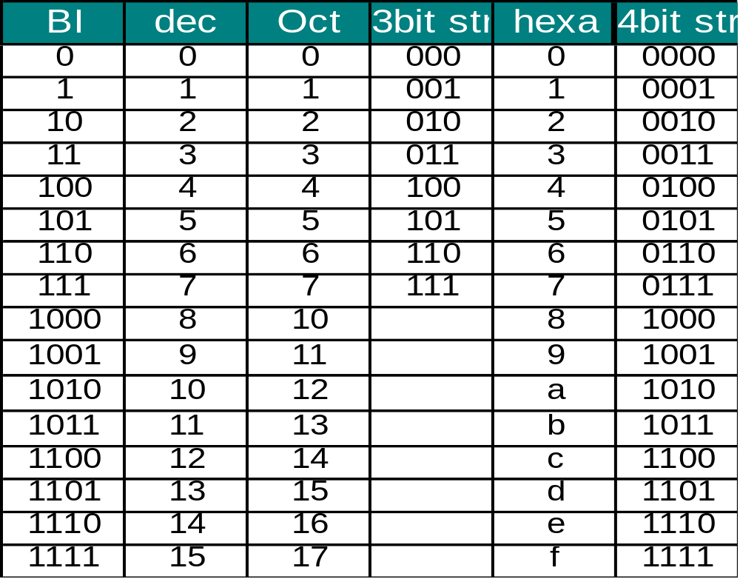
Binary Arithmetic
Binary, Octal, Decimal, and Hexadecimal numbers
Julio D. Dondo Gazzano FPGA & VHDL WORKSHOP KUMASI GHANA- 2005

Slide 50
Hexadecimal numbering system (base 16)
Hexadecimal uses 4-bit groupings; therefore, instructions or data used in 8, 16, or 32 bit computer systems can be represented as a 2, 4 or 8 digit hexadecimal code
To signify a hex number the subscript 16 or the letter H is used

Slide 51
Decimal | Binary | Hexadecimal | octal
0 1 2 3 4 5 6 7 8 9 10 11 12 13 14 15 | 0000 0001 0010 0011 0100 0101 0110 0111 1000 1001 1010 1011 1100 1101 1110 1111 | 0 1 2 3 4 5 6 7 8 9 A B C D E F | 0 1 2 3 4 5 6 7
16 17 | 10000 10001 | 10 11

Slide 52
Example
0110 1101₂
6
D
6D₁₆
To indicate a hexadecimal value we can also use prefix $ or subscript 16.
  eg $1FED or 1FED₁₆

Slide 53
Conversion- Hexadecimal to Binary
Write each hexadecimal digit as a 4-bit binary number
  Example
  $FD69A
  = %1111 1101 0110 1001 1010
1.15

Slide 54
Hexadecimal
Radix=16
Symbols are: 0,1,2,3,4,5,6,7,8,9,A,B,C,D,E,F
Positional values are: 16⁴ 16³ 16² 16¹ 16⁰
Decimal values are: 65,536 4096 256 16 1
    Eg 1D7E₁₆=1 x 16³ + D x 16² + 7 x 16¹ + E x 16⁰
    =1 x 4096 + 13 x 256+7 x 16 + 14 x 1=7550₁₀
Student Exercises: Convert to decimal:
$7E=
$A8=
$13BF=
1.7

Slide 55
Octal Numbers
Radix=8
Symbols are: 0,1,2,3,4,5,6,7.
Positional values are: 8⁴ 8³ 8² 8¹ 8⁰
Decimal values are: 4096 512 64 8 1
    eg 1573₈=1 x 8³ + 5 x 8² + 7 x 8¹ + 3 x 8⁰
    =1 x 512 + 5 x 64 + 7 x 8 + 3 x 1
    =512 + 320 + 56 + 3
    =891₁₀
1.9

Slide 56
Conversion- Hexadecimal to Binary
Student Exercises
Convert the following hexadecimal values to binary:
$FE45 =
$BBB775 =
ABCDEF₁₆ =
1.16

Slide 57
Conversion- Binary to Hexadecimal
Write each group of 4 binary bits as the equivalent Hexadecimal value.
Example
%0101 1110 1010 1011 1111 0001
= $5EABF1
NOTE: Start at the right hand end and fill the left hand end with zeros to get 4 bits.
1.17
Notes:
Not sure about the -$5EABF

Slide 58
Conversion- Binary to Hexadecimal
Student Exercises
Convert the following binary values to hexadecimal:
% 1 0000 1010 1110 1111 0010 =
0001 0001 0011 1010 1011₂ =
% 1010001110001100011000 =
1111110001010101010010₂ =
1.18

Slide 59
Alphanumeric Codes
ASCII, EBCIDIC & Unicode codes
ASCII Code- American Standard Code for Information Interchange
-7 bit code used world wide
-there are 127 different characters
-10 digits, 0-9
-26 uppercase letters
-26 lowercase letters
-7 punctuation marks
-33 control characters
-26 other characters
-usually stored in a computer in an 8-bit byte with the most significant bit left as 0.
1.53

Slide 60
ASCII CHART
MSB
LSB
000 001 010 011 100 101 110 111
0000 NUL DLE sp 0 @ P ` p
0001 SOH DC1 ! 1 A Q a q
0010 STX DC2 “ 2 B R b r
0011 ETX DC3 # 3 C S c s
0100 EOT DC4 $ 4 D T d t
0101 ENQ NAK % 5 E U e u
0110 ACK SYN & 6 F V f v
0111 BEL ETB ‘ 7 G W g w
1000 BS CAN ( 8 H X h x
1001 HT EM ) 9 I Y i y
1010 LF SUB * : J Z j z
1011 VT ESC + ; K [ k {
1100 FF FS , < L \ l
1101 CR GS - = M ] m }
1110 SO RS . > N n ~
1111 SI US / ? O o DEL
1.55

Slide 61
Codes
EBCIDC -an 8 character code invented by IBM
-256 characters
Unicode -this is a new code to cater for many of the world’s languages
-a subset corresponds to ASCII
-uses 16 bits to represent each character
1.54

Slide 62
Codes
Collating Sequence
-the order assigned within a code
-for ASCII
A 100 0001
B 100 0010
C 100 0011
D 100 0100
0 011 0000
1 011 0001
2 011 0010
Thus characters and text can be compared:
A<D
FRED<FREE
0<7
X>P
1.56

Slide 63
Codes - ASCII to binary conversion
This conversion is frequently executed by a computer to convert keyboard keys which are in ASCII to binary, when arithmetic is to be carried out.
ASCII for ‘1’= 0011 0001
To convert to binary for arithmetic, subtract %0011 000 which leaves %0000 0001.
Similarly, when printing a binary number, such as %0000 1001, (=9),the computer must add %0011 0000 to give %0011 1001 which is ASCII for ‘9’.
Converting multi-digit binary numbers, such as %1100 1110 to the ASCII characters ‘206’ is much more complex.
1.57

Slide 65
ASCII
Student Exercises
1. Convert the text string ‘Yoko’s in Tokyo’ to 7-bit ASCII string.
2. Convert the string ‘Mary’s eyes are blue’ to an 8-bit ASCII string.
3. Convert the 7-bit ASCII code to text:
10001111101111110111111001000100000
1101101110111111100101101110110100111011101100111010
0000100110111100100100000101001111011011101001111010
011010000101110
4. Convert the ASCII 8-bit code to text:
01001000011011110110110001101001
01100100011000010111100100101110
1.58

Slide 66
BCD Codes
BCD- Binary Coded Decimal numbers are used in systems where only numbers are being entered.
BCD arithmetic can be performed without the need to convert to binary.
BCD Table: 0= 0000 5= 0101
1= 0001 6= 0110
2= 0010 7= 0111
3= 0011 8= 1000
4= 0100 9= 1001
Codes 1010 to 1111 are not used.
Example 1,295= 0001 0010 1001 0101
1.71

Slide 68
Thank you and Good Luck !!
F. K. Ampong FPGA & VHDL WORKSHOP KUMASI GHANA- 2005

